Slide 1
Capston project Final presentation
Find the a great location to start a new business in switzerland (backery)
Marco Pfeiffer Coursera Capstone

Slide 2
Introduction and Business Problem
Mario wants to start a new business. He wants to open a bakery. It is important to him to start his business near a large town in switzerland. He doesn't know how to find the best location.
In order to find the best location for mario we need to get information about the near environment of the largest cities in switzerland.
We need to find a location with not too much competition but with enough customers to run a successful business.

Slide 3
Data
To help Mario to find the perfect location for his backery we will need to access following data:
Mario wants to open his bakery in a large city in switzerland. The main cities with the total number of citizens we will get from
wikipedia: https://de.wikipedia.org/wiki/Liste_der_St%C3%A4dte_in_der_Schweiz
The coordinates (latitude, longitude) ot these Localities we will get from Open Street Map APIs
From Foursquare we will need following venues data: (exact infomation can be obtained here: https://developer.foursquare.com/docs/resources/categories)
bakery data location data and names
offices / working places location data and names
universities / school location data and names
leisure and nature spots data and names
We will use this data to find out which loaction is most suitable for marios bakery.

Slide 4
Methodology
The captial locations are dynamically collected from a wikipedia site.
For each location the following data was collected from the „Foursquare“ API: Working places, nature/leisure spots, backery data and universities/ schools.
For each capital the sums of the categories are calculated.
For each category a weight or penalty score is defined and used to identify the best location:
Other backery shops have been weighted with a negative number, because we want to avoid competition
The other categories get weighted according to their positive effect.
The weights can be modified according to the importance of each category.
At the end a score was computed for each location.

Slide 5
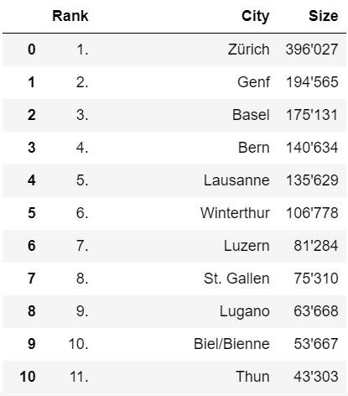
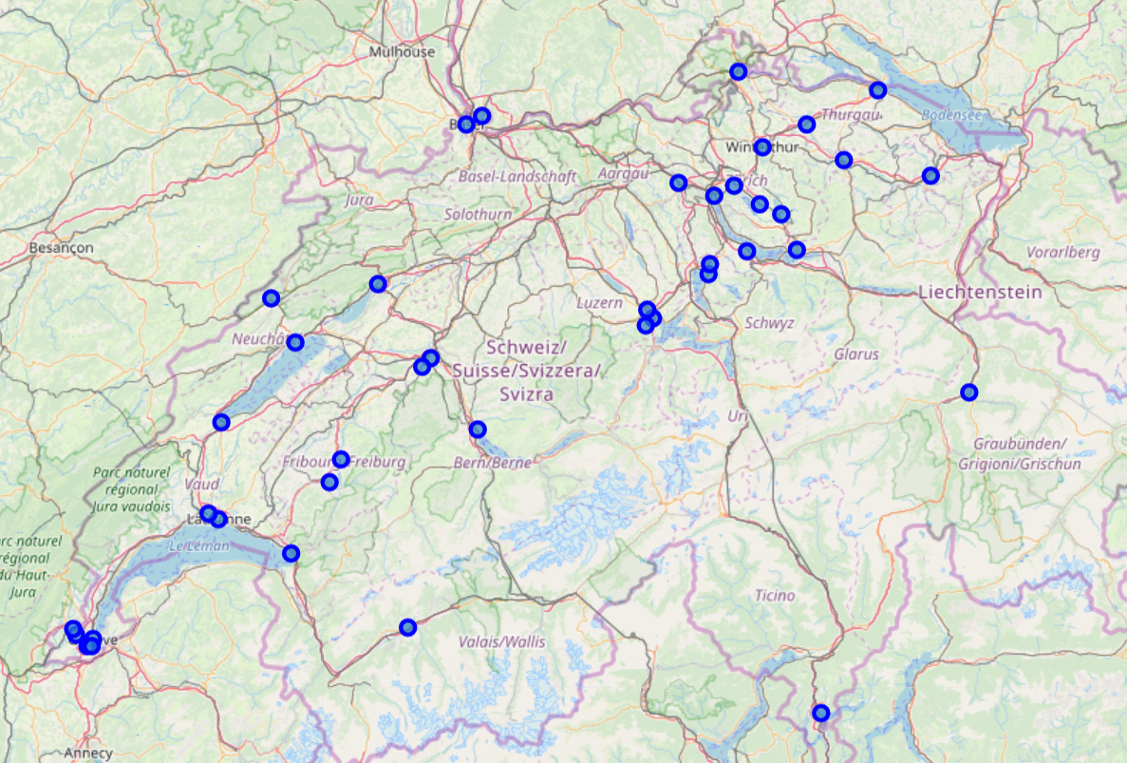
Capitals, Switzerland
Example Data

Slide 6
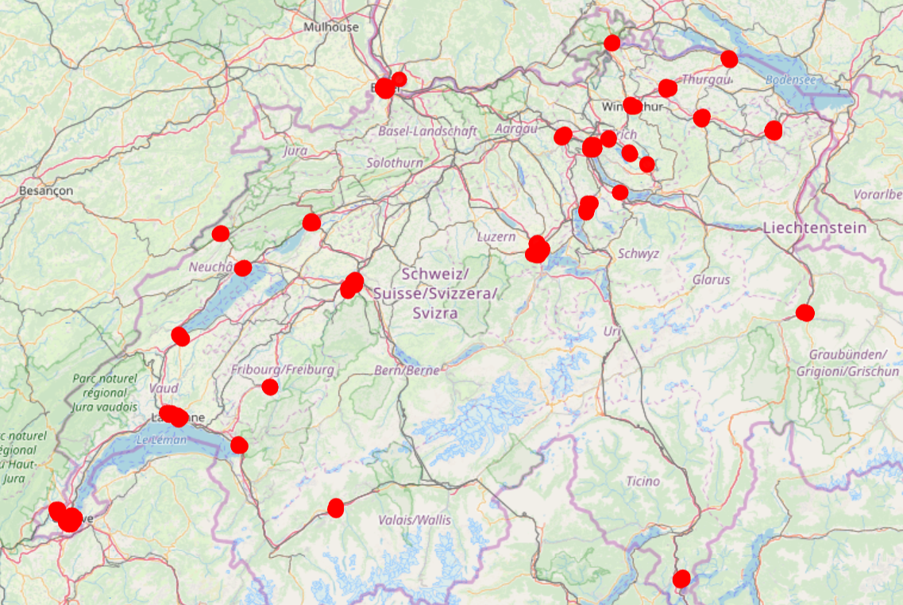
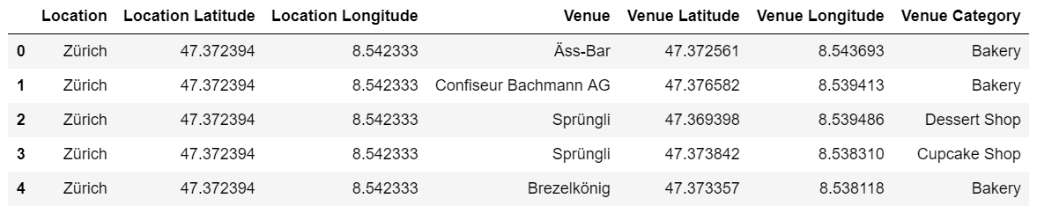
Baker‘s near the capitals
Example Data

Slide 7
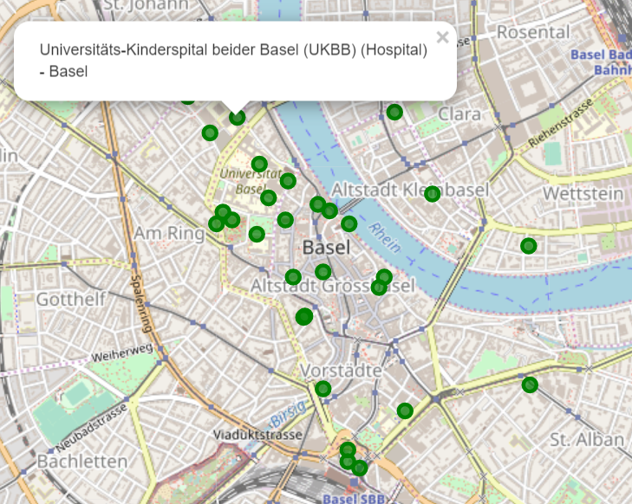
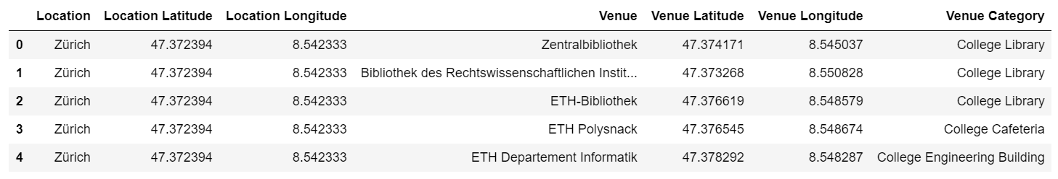
School‘s and universities near the capitals
Example Data

Slide 8
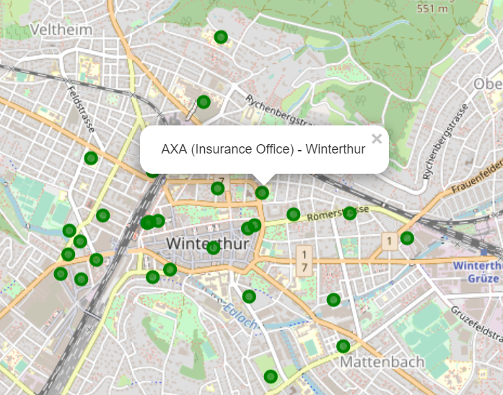
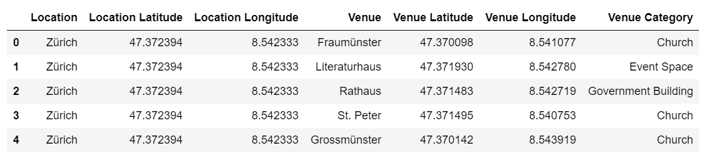
Working places near the capitals
Example Data

Slide 9
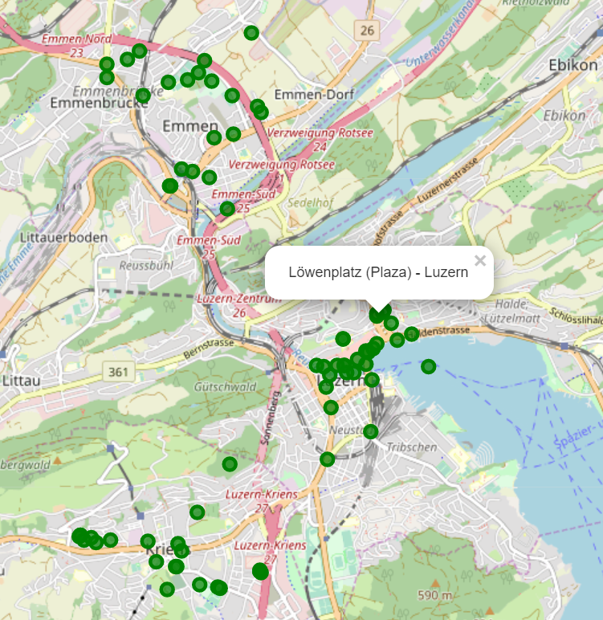
Leisure and nature spots near the capitals
Example Data

Slide 10
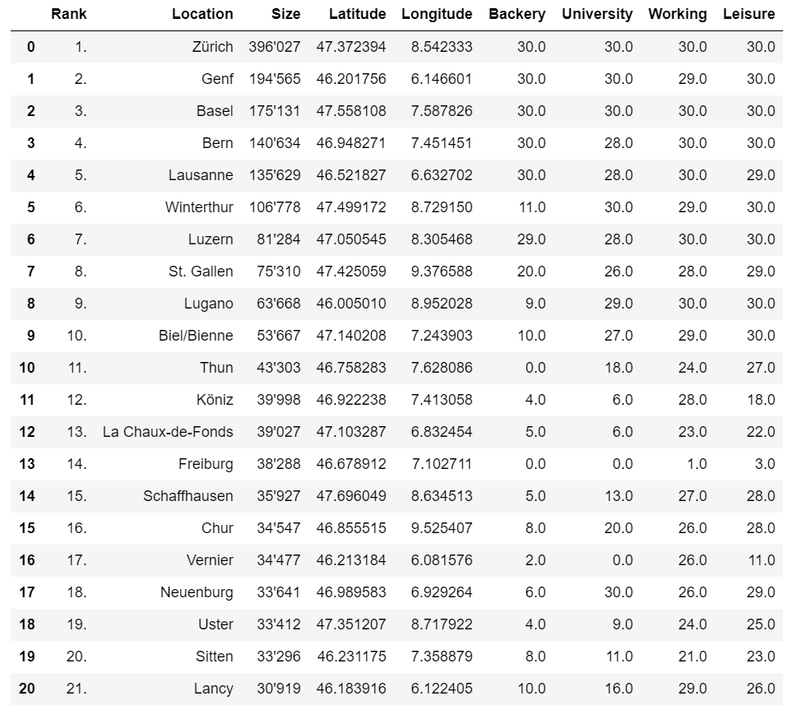
Combining the data by Location

Slide 11
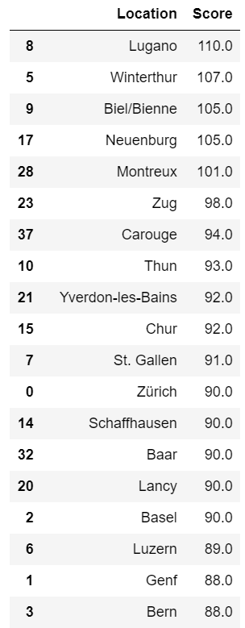
Results
The best location with a score of 110 is Lugano. Mario should open his new bakery there.
The next best location would be Wintherthur followd by Biel/Bienne and Neuenburg.
By choosing Lugano as the location Mario reduces the competition. At the same time the location is suits his needs best becaus the spot is near growded areas. That is why he should have enough potential customers.

Slide 12
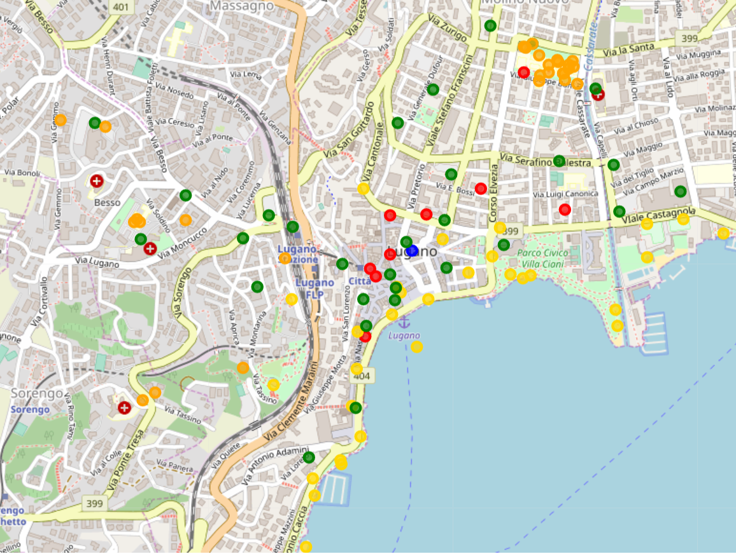
Winner Location
RED: Competition
GOLD: Nature/Leisure spots
GREEN: Working places
ORANGE: Universities/schools

Slide 13
Improvements / Recommendations
To improve the analysis the categories should be filtered in more detail. I mainly worked with the top categories to get enough results
The size of the capital (number of citizens) could have an impact on the potential customers per day.
In the location itself, the distance between all potential customer „spots“ could be measured and weighted. At the moment all customer spots are equally weighted.
Rent prices are not considered, but could make a difference if you are planning to start a business somewhere.

